Slide 1
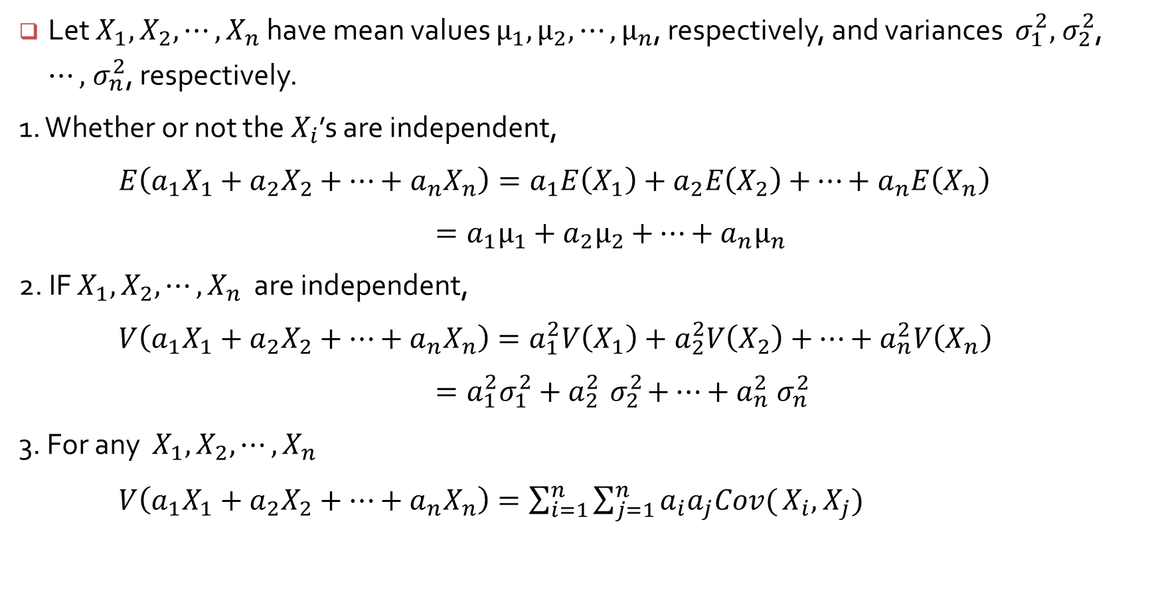
Properties of sample mean and sample sum
Let $X_{1},$ $X_{2},⋯, X_{n}$ have mean values $μ_{1},μ_{2},⋯, μ_{n}$, respectively, and variances $σ_{1}^{2}, { σ}_{2}^{2}$, $⋯,{ σ}_{n}^{2}$, respectively.
1. Whether or not the $X_{i}$’s are independent,
$E\left({a_{1}X}_{1}+a_{2}X_{2}+⋯+a_{n}X_{n}\right)=a_{1}E\left(X_{1}\right)+a_{2}E\left(X_{2}\right)+$ $⋯+a_{n}E\left(X_{n}\right)$
$=a_{1}μ_{1}+a_{2}μ_{2}+$ $⋯+a_{n}μ_{n}$
2. IF $X_{1},$ $X_{2},⋯, X_{n}$ are independent,
$V\left({a_{1}X}_{1}+a_{2}X_{2}+⋯+a_{n}X_{n}\right)=a_{1}^{2}V\left(X_{1}\right)+a_{2}^{2}V\left(X_{2}\right)+$ $⋯+a_{n}^{2}V\left(X_{n}\right)$
$=a_{1}^{2}σ_{1}^{2}+a_{2}^{2}{ σ}_{2}^{2}+$ $⋯+a_{n}^{2}{ σ}_{n}^{2}$
3. For any $X_{1},$ $X_{2},⋯, X_{n}$
$V\left({a_{1}X}_{1}+a_{2}X_{2}+⋯+a_{n}X_{n}\right)=\sum_{i=1}^{n}{\sum_{j=1}^{n}{a_{i}a_{j}Cov(}}X_{i},$ $X_{j})$

Slide 2
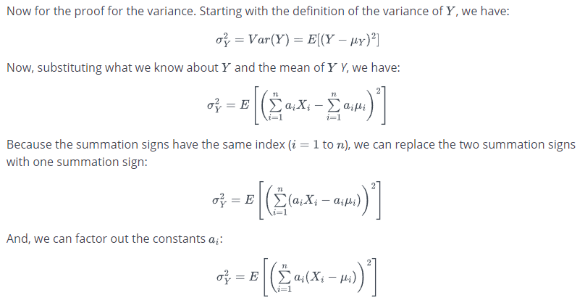
Variance of Linear Combinations - https://online.stat.psu.edu/stat414/lesson/24/24.3

Slide 3
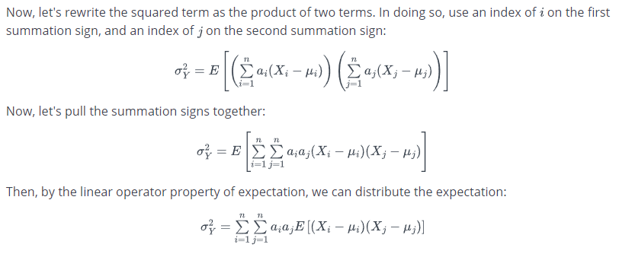
Variance of Linear Combinations - https://online.stat.psu.edu/stat414/lesson/24/24.3

Slide 4
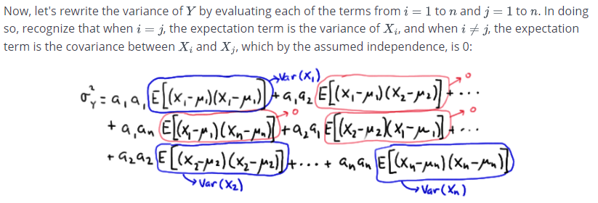
Variance of Linear Combinations - https://online.stat.psu.edu/stat414/lesson/24/24.3

Slide 5
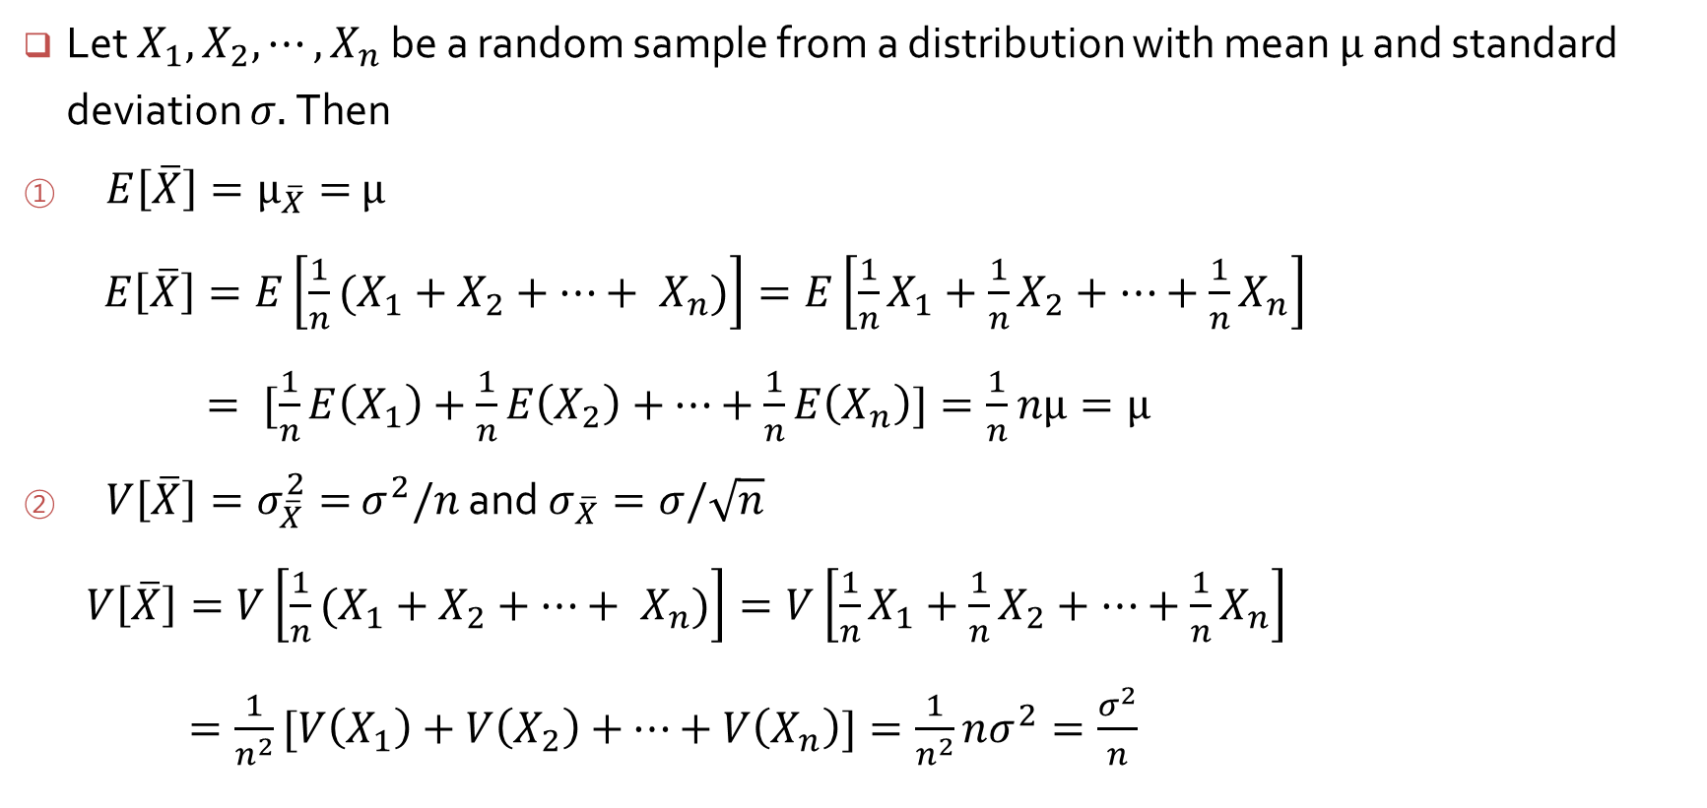
Properties of sample mean and sample sum
Let $X_{1},$ $X_{2},⋯, X_{n}$ be a random sample from a distribution with mean $μ$ and standard deviation $σ.$Then
$E\left[\overline{X}\right]=μ_{\overline{X}}=$ $μ$
$E\left[\overline{X}\right]=E\left[\frac{1}{n}(X_{1}+X_{2}+⋯+ X_{n})\right]=E\left[\frac{1}{n}X_{1}+\frac{1}{n}X_{2}+⋯+\frac{1}{n}X_{n}\right]$
$= [\frac{1}{n}E\left(X_{1}\right)+\frac{1}{n}E\left(X_{2}\right)+$ $⋯+\frac{1}{n}E\left(X_{n}\right)]=\frac{1}{n}$ $nμ=μ$
$V\left[\overline{X}\right]=σ_{\overline{X}}^{2}=$ $σ^{2}/n$ and $σ_{\overline{X}}=σ/\sqrt{n}$
$V\left[\overline{X}\right]=V\left[\frac{1}{n}(X_{1}+X_{2}+⋯+ X_{n})\right]=V\left[\frac{1}{n}X_{1}+\frac{1}{n}X_{2}+⋯+\frac{1}{n}X_{n}\right]$
$=\frac{1}{n^{2}}[V\left(X_{1}\right)+V\left(X_{2}\right)+$ $⋯+V\left(X_{n}\right)]=\frac{1}{n^{2}}nσ^{2}=\frac{σ^{2}}{n}$

Slide 6
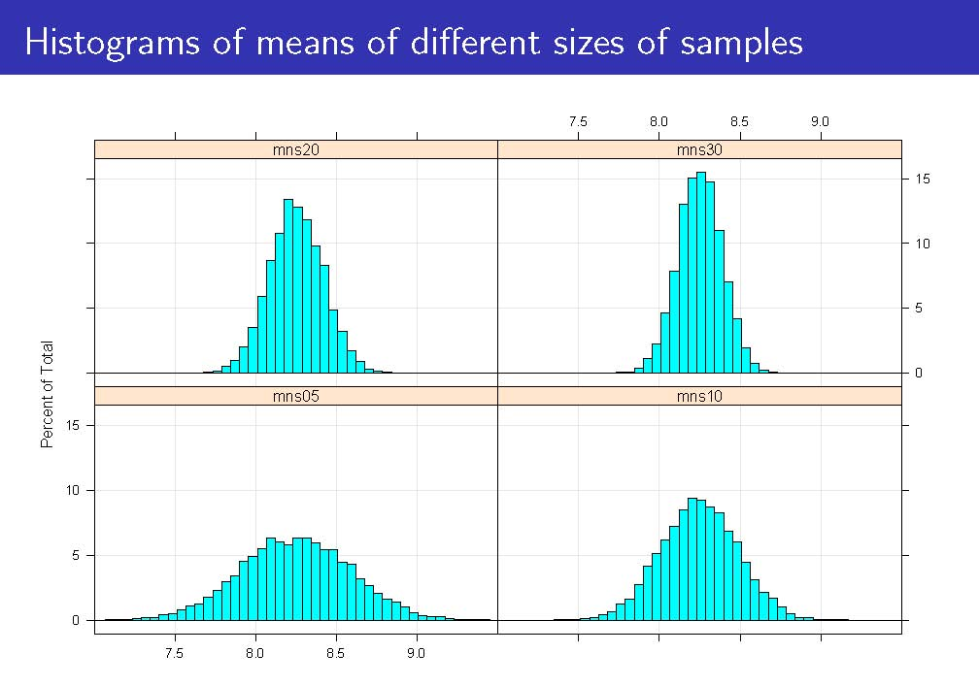

Slide 7
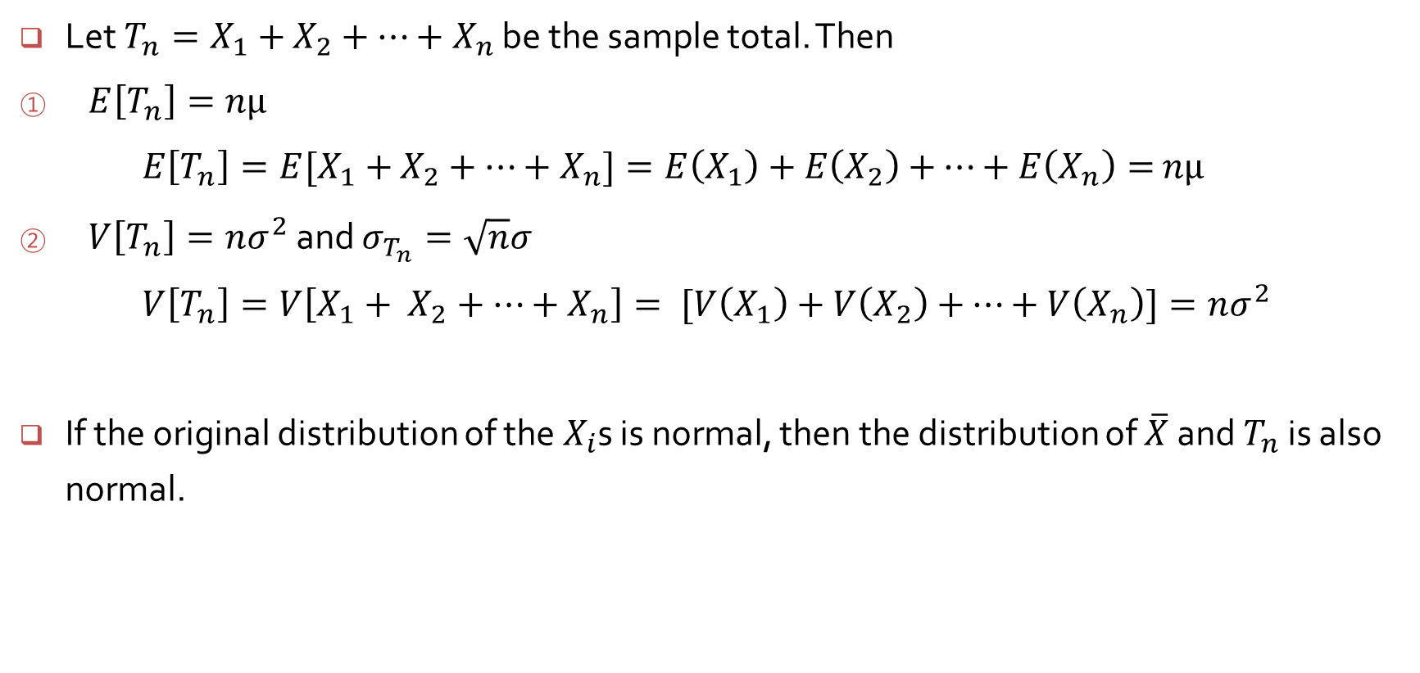
Properties of sample mean and sample sum
Let $T_{n}=X_{1}+$ $X_{2}+⋯+X_{n}$ be the sample total. Then
$E\left[T_{n}\right]=nμ$
$E\left[T_{n}\right]=E[X_{1}+$ $X_{2}+⋯+X_{n}]=E\left(X_{1}\right)+E\left(X_{2}\right)+$ $⋯+E\left(X_{n}\right)=$ $nμ$
$V\left[T_{n}\right]=nσ^{2}$ and $σ_{T_{n}}=\sqrt{n}σ$
$V\left[T_{n}\right]=V\left[X_{1}+ X_{2}+⋯+X_{n}\right]= [V\left(X_{1}\right)+V\left(X_{2}\right)+$ $⋯+V\left(X_{n}\right)]=nσ^{2}$
If the original distribution of the $X_{i}$s is normal, then the distribution of $\overline{X}$ and $T_{n}$ is also normal.

Slide 8
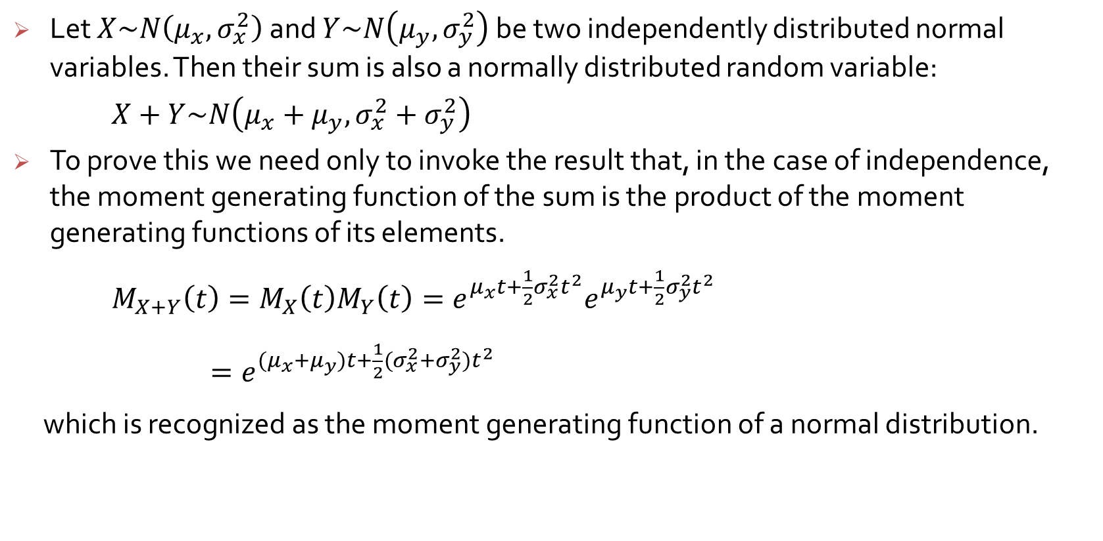
Sum of the Normal Distributions
Let $X\sim N\left(μ_{x}, σ_{x}^{2}\right)$and $Y\sim N\left(μ_{y}, σ_{y}^{2}\right)$be two independently distributed normal variables. Then their sum is also a normally distributed random variable:
$X+Y\sim N\left(μ_{x}+μ_{y}, σ_{x}^{2}+σ_{y}^{2}\right)$
To prove this we need only to invoke the result that, in the case of independence, the moment generating function of the sum is the product of the moment generating functions of its elements.
$M_{X+Y}\left(t\right)=M_{X}\left(t\right)M_{Y}\left(t\right)=e^{μ_{x}t+\frac{1}{2}σ_{x}^{2}t^{2}}e^{μ_{y}t+\frac{1}{2}σ_{y}^{2}t^{2}}$
$=e^{(μ_{x}+μ_{y})t+\frac{1}{2}{(σ}_{x}^{2}{+σ_{y}^{2})t}^{2}}$
which is recognized as the moment generating function of a normal distribution.

Slide 9
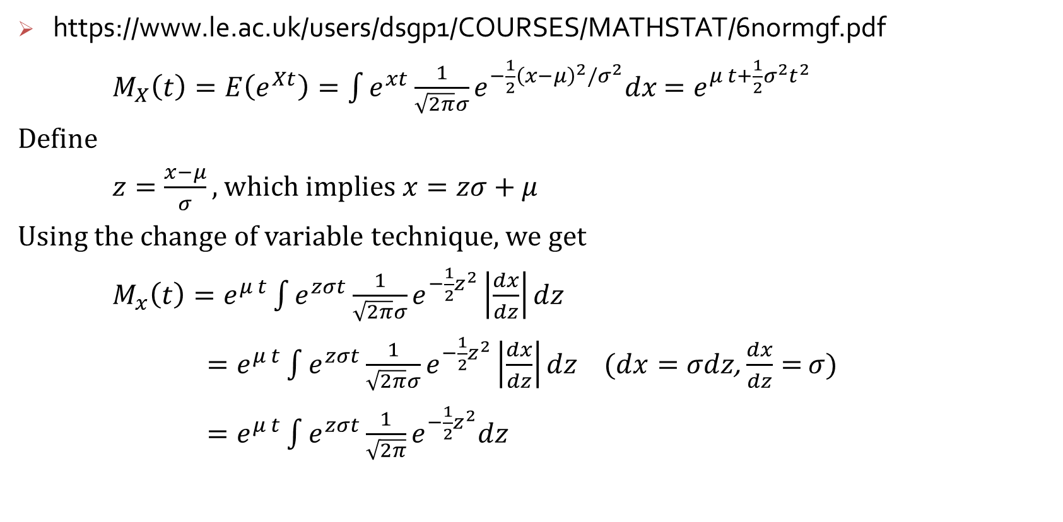
Moment Generating Function of the Normal Distribution
https://www.le.ac.uk/users/dsgp1/COURSES/MATHSTAT/6normgf.pdf
$M_{X}\left(t\right)=E\left(e^{Xt}\right)=\int{e^{xt}}\frac{1}{\sqrt{2π}σ}e^{−\frac{1}{2}{\left(x−μ\right)}^{2}/σ^{2}}dx$ $=e^{μ t+\frac{1}{2}σ^{2}t^{2}}$
Define
$z=\frac{x−μ}{σ},$which implies $x=zσ+$ $μ$
Using the change of variable technique, we get
$M_{x}\left(t\right)=e^{μ t}\int{e^{zσt}}\frac{1}{\sqrt{2π}σ}e^{−\frac{1}{2}z^{2}}\left|\frac{dx}{dz}\right|dz$
$=e^{μ t}\int{e^{zσt}}\frac{1}{\sqrt{2π}σ}e^{−\frac{1}{2}z^{2}}\left|\frac{dx}{dz}\right|dz$ $(dx=σdz$, $\frac{dx}{dz}=$ $σ)$
$=e^{μ t}\int{e^{zσt}}\frac{1}{\sqrt{2π}}e^{−\frac{1}{2}z^{2}}dz$

Slide 10
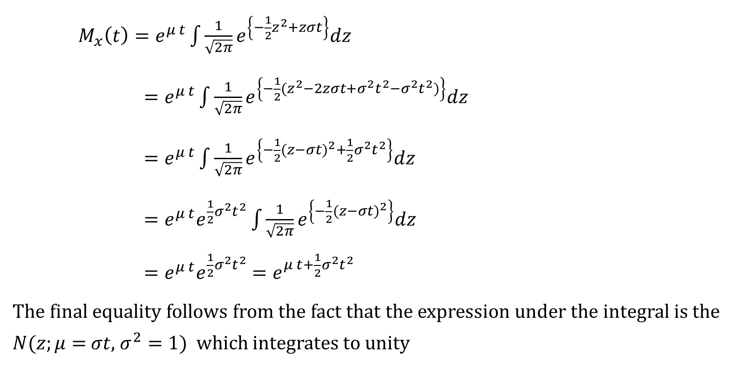
Moment Generating Function of the Normal Distribution
$M_{x}\left(t\right)=e^{μ t}\int{\frac{1}{\sqrt{2π}}e^{\left\{−\frac{1}{2}z^{2}+zσt\right\}}dz}$
$=e^{μ t}\int{\frac{1}{\sqrt{2π}}e^{\left\{−\frac{1}{2}{(z}^{2}−2zσt+σ^{2}t^{2}−σ^{2}t^{2})\right\}}dz}$
$=e^{μ t}\int{\frac{1}{\sqrt{2π}}e^{\left\{−\frac{1}{2}{(z−σt)}^{2}+\frac{1}{2}σ^{2}t^{2}\right\}}dz}$
$=e^{μ t}e^{\frac{1}{2}σ^{2}t^{2}}\int{\frac{1}{\sqrt{2π}}e^{\left\{−\frac{1}{2}{(z−σt)}^{2}\right\}}dz}$
$=e^{μ t}e^{\frac{1}{2}σ^{2}t^{2}}$ $=e^{μ t+\frac{1}{2}σ^{2}t^{2}}$
The final equality follows from the fact that the expression under the integral is the $N(z;μ=$ $σt$, $σ^{2}=1)$which integrates to unity

Slide 11
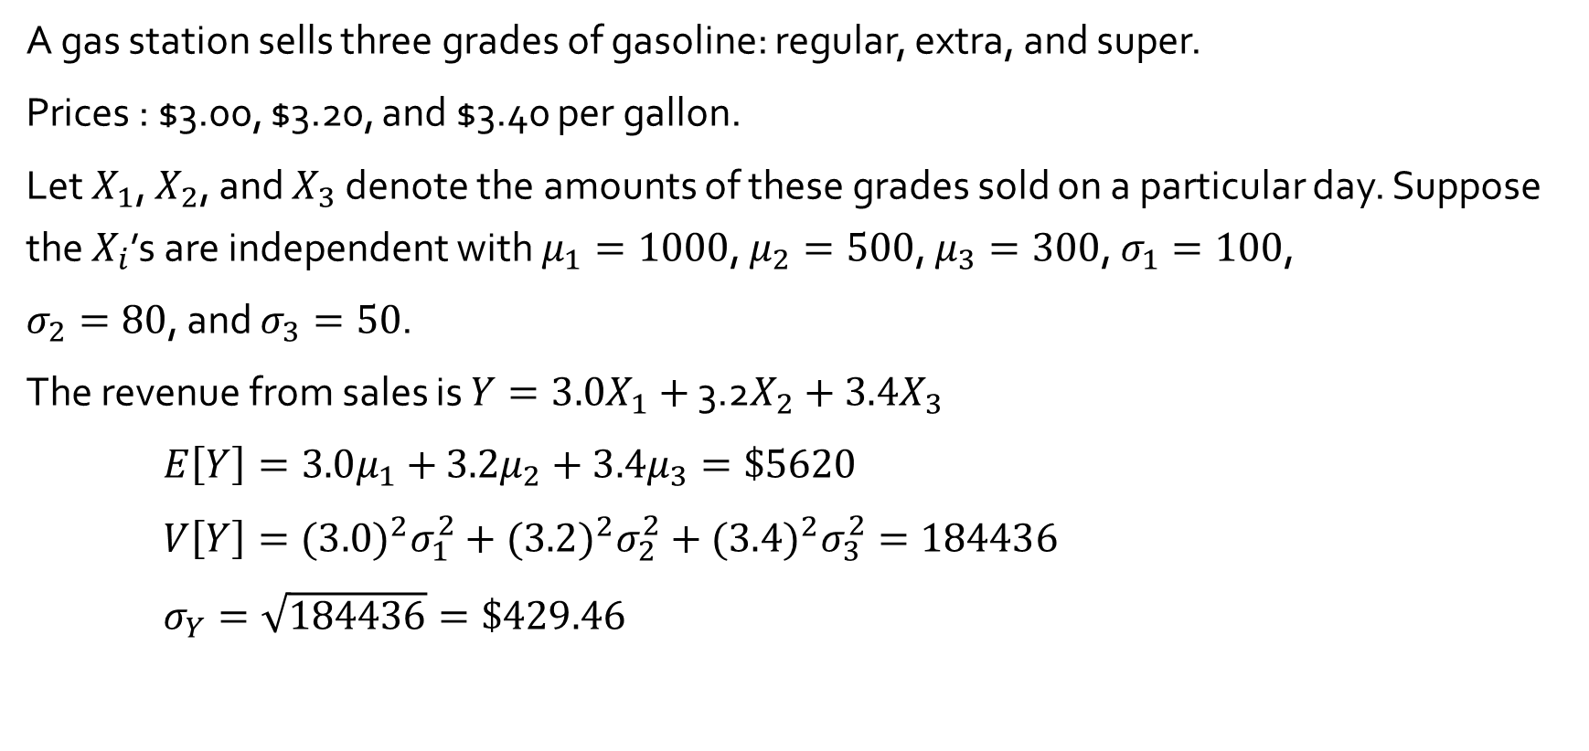
Properties of sample mean and sample sum : Example 5.29
A gas station sells three grades of gasoline: regular, extra, and super.
Prices : $3.00, $3.20, and $3.40 per gallon.
Let $X_{1}$, $X_{2}$, and $X_{3}$ denote the amounts of these grades sold on a particular day. Suppose the $X_{i}$’s are independent with $μ_{1}=1000$, $μ_{2}=500$, $μ_{3}=300$, $σ_{1}=100$,
$σ_{2}=80$, and $σ_{3}=50$.
The revenue from sales is $Y={3.0X}_{1}+$ 3.2$X_{2}+3.4X_{3}$
$E\left[Y\right]=3.0μ_{1}+$ $3.2μ_{2}+$ $3.4μ_{3}=\$5620$
$V\left[Y\right]={(3.0)}^{2}σ_{1}^{2}+{(3.2)}^{2}σ_{2}^{2}+{(3.4)}^{2}σ_{3}^{2}=184436$
$σ_{Y}=\sqrt{184436}=\$429.46$

